Slide 1
Lab 2
Logic Instructions with the ARM processor
Julio César Almada Fuerte
A00226046
ITE

Slide 2
Part 1
Counts the longest strings of 1´s
Example: 0x103fe00f ->9

Slide 3
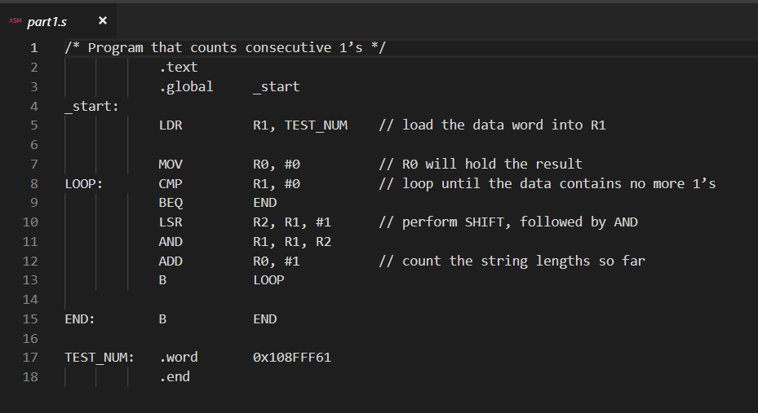

Slide 4
PART 2
Do the same as the part 1 but in a subroutine.
Check for the largest string of 1s from across 10 words in memory on the label TEST_NUM

Slide 5
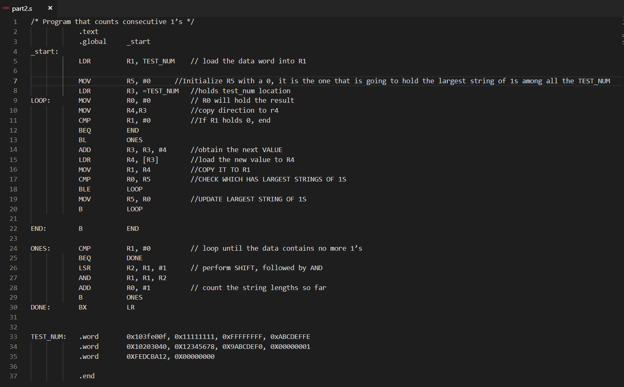

Slide 6
PART 3
Check for the longest string of 1´s and put the result into register R5
Check for the longest string of 0´s and put the result into register R6
Check for the longest string of alternating 1´s and 0´s, and put the result into register R7

Slide 7
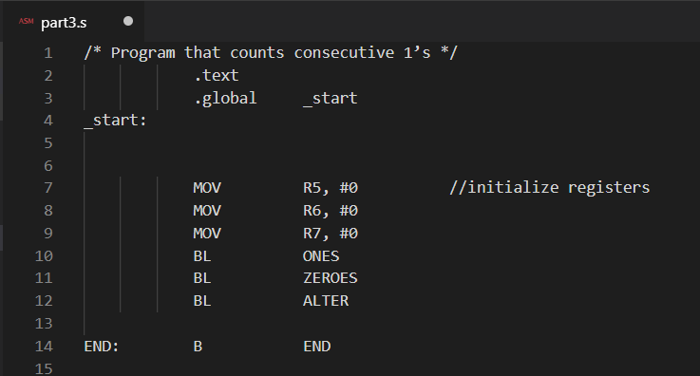

Slide 8
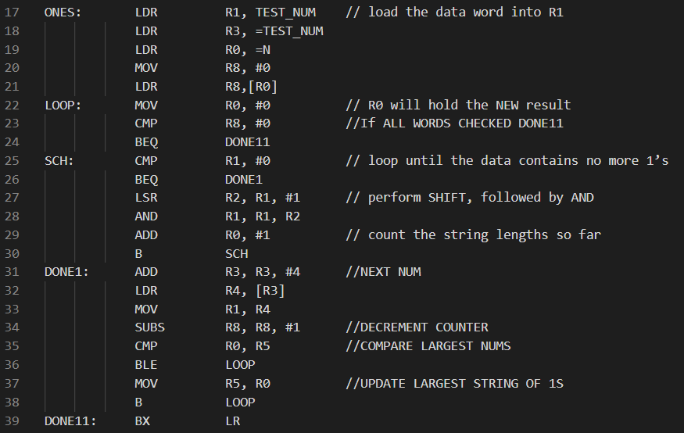

Slide 9
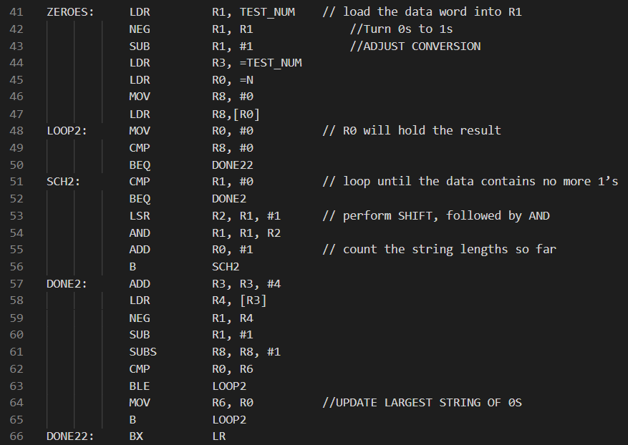

Slide 10
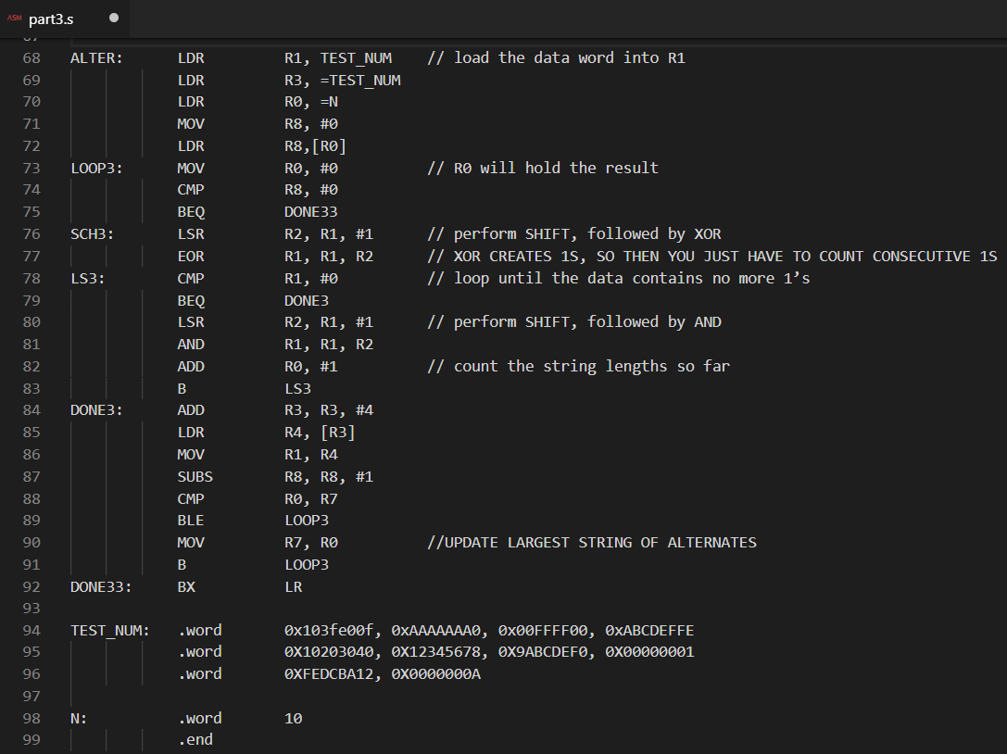

Slide 11
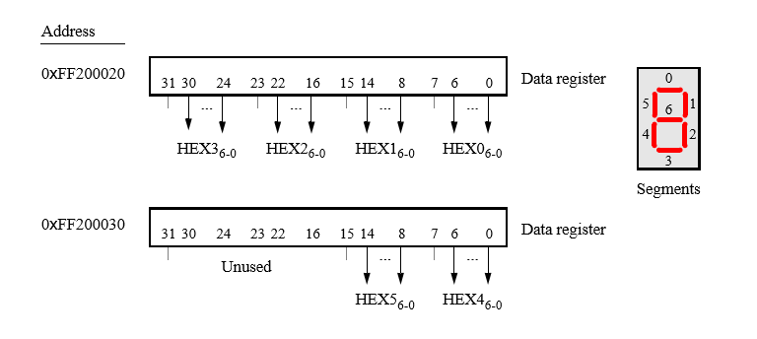
PART 4
Do the same as part 3 but print the result of each register on the 7-segment displays

Slide 12
The 7 –segment displays are memory mapped
Hex3-0: 0xFF200020
Hex5-4: 0xFF200030
To show each number, it is necessary to light up the appropriate display segment and store it into the address 0xFF200020 to show the result.
Example: 0 -> 00111111

Slide 13
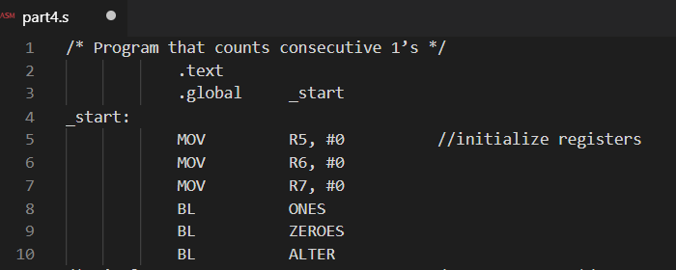

Slide 14
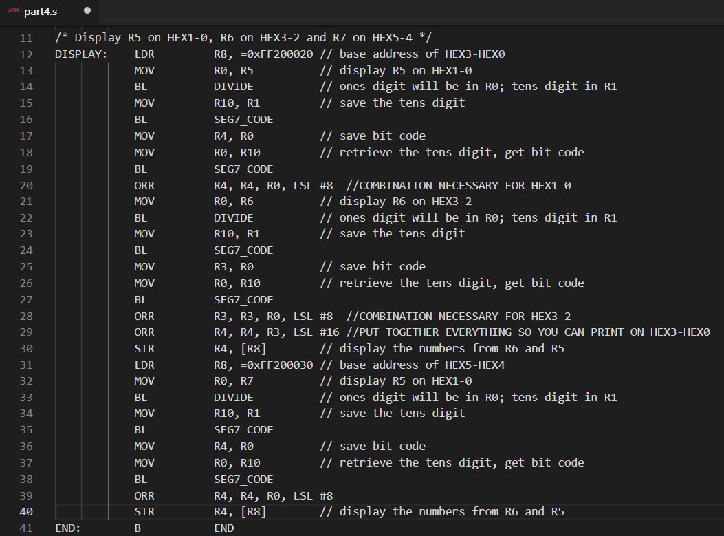

Slide 15
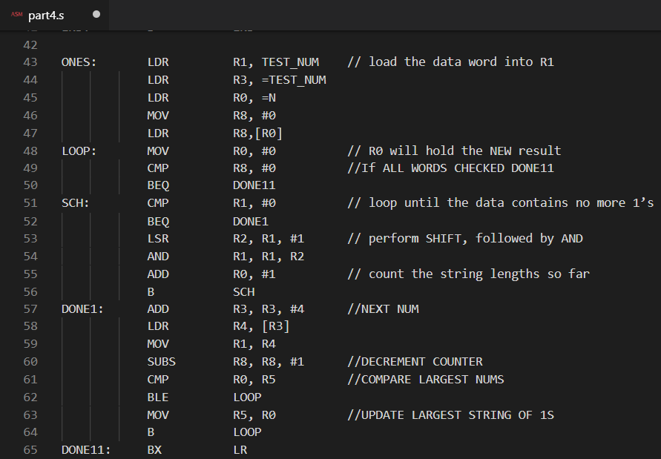

Slide 16
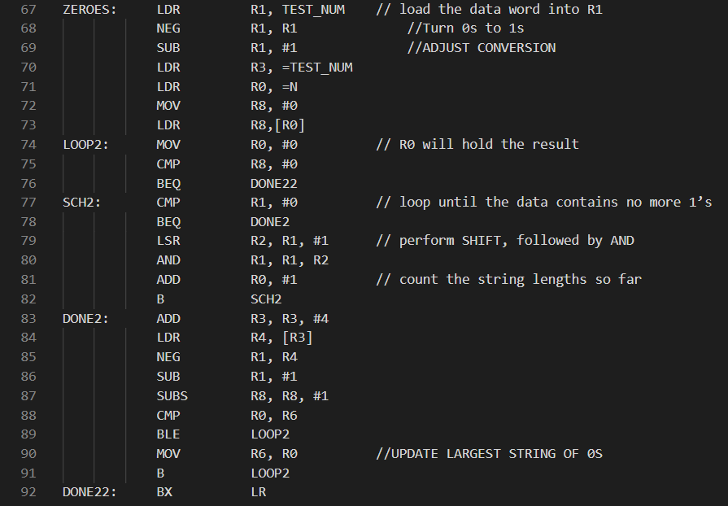

Slide 17
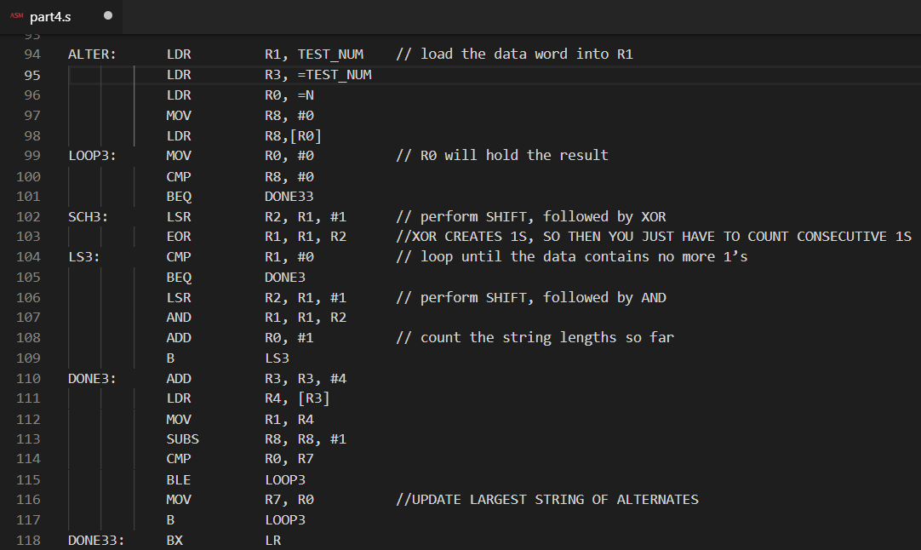

Slide 18
